Slide 1
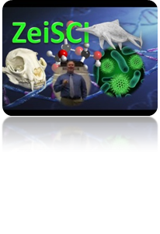
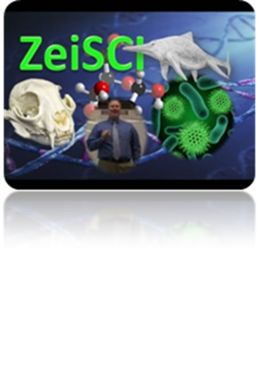
Teacher Notes
My 10th grade Biology students study both eukaryotic and prokaryotic cellular respiration pathways (aerobic and anaerobic). I use this to introduce and summarize the "BIG IDEAS" in cellular respiration. Students enjoy bringing in empty energy drink cans to do their initial research.
This lesson includes a FUN ENGAGE ACTIVITY for 5E learning model as well as material for the EXPLORE and EXPLAIN phases. The flowchart is included to allow students to summarize the big ideas. The following are the NGSS content correlations for both middle and high school levels. Specific standards are hyperlinked within the PowerPoint: - HS-LS1 From Molecules to Organisms: Structures and Processes - MS-LS1 From Molecules to Organisms: Structures and Processes Lesson includes all of the following: 1. An engage activity with energy drinks is used to capture their interest.
2. An explore activity to analyze key ingredients. 3. Editable flowchart for eukaryotes and prokaryotes with answer keys (answers are in red). 4. Editable PowerPoint slides with energy drink ingredient explanation If you have any questions feel free to email me at bzeiszler@gmail.com . Thanks, Brian Zeiszler M.S. Science Education Cellular Respiration FlowChart by Brian Zeiszler is licensed under a Creative Commons Attribution-NonCommercial 4.0 International License.

Slide 2
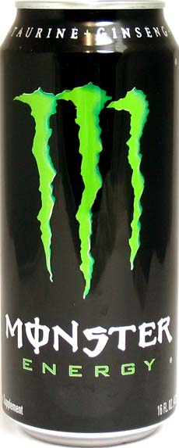
Do These
Really Work?
Eukaryotic and Prokaryotic Cellular Respiration
Grades 7-12
NGSS correlated

Slide 3
Do These
Really Work?
NGSS, high school
HS-LS1 From Molecules to Organisms: Structures and Processes
HS-LS1-6
HS-LS1-7
Notes:
Standards are hyperlinked.

Slide 4
Do These
Really Work?
NGSS, 6-8th grade
MS-LS1 From Molecules to Organisms: Structures and Processes
MS-LS1-7
Notes:
Standards are hyperlinked.

Slide 5
Common Ingredients ?????? Bring in an empty energy drink can and compare to other students cans.
Do These
Really Work?
Notes:
Have students bring in empty energy drink cans and find ingredients that are common to all. Examples: Monster Energy, Red Bull, Rockstar, etc. If you or your students don’t have access to these cans, use the worksheet on the next slide.

Slide 6
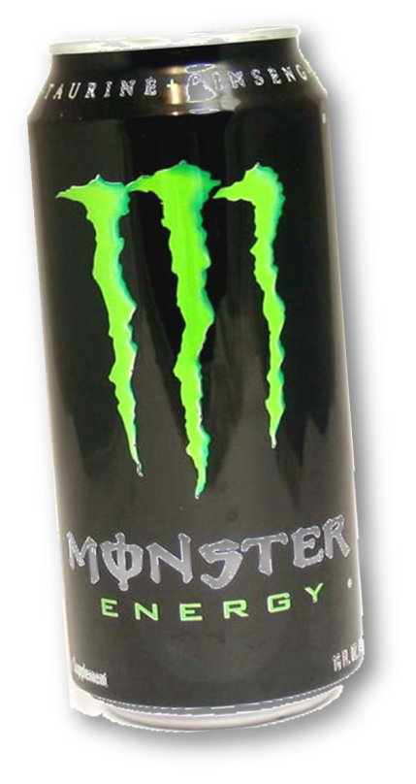
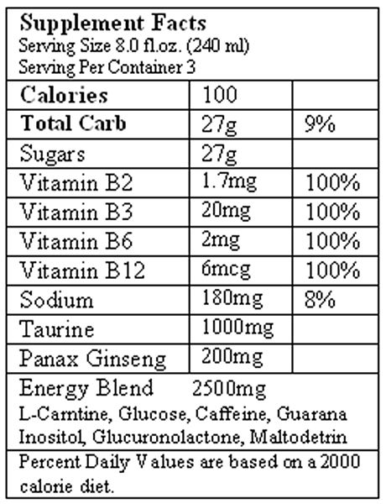
Do These
Really Work?
1. What is the alternative name for each of the vitamins in the Monster nutrition facts?
2. Choose 2 of the ingredients above and tell me your opinion on how they specifically provide “energy” to the consumer.
3.Do other energy drinks share any of these ingredients in common? Which ingredients?

Slide 7
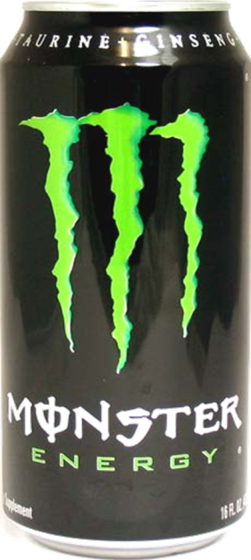
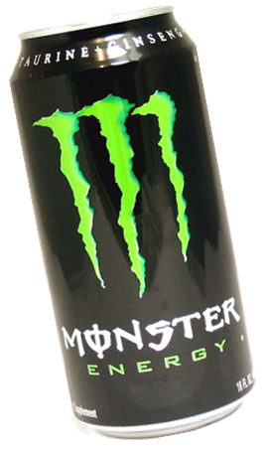
Using the internet, your book or any of the other books on the shelves answer the following question:
What do each of the following ingredients in an energy drink DO to give you energy?
Riboflavin
Glucose
Citric Acid
Niacinamide
GIVE THE PAGE NUMBERS OR WEB PAGE OF A POSSIBLE ANSWER AND WRITE A BRIEF SUMMARY OF WHY THEY MIGHT GIVE ME ENERGY. THIS IS JUST AN ASSIGNMENT TO SEE WHAT YOU COME UP WITH. I'M NOT NECESSARILY LOOKING FOR THE EXACT, RIGHT ANSWER.
think...

Slide 8
Energy Drink Components Student Groups
Riboflavin:
Gaby
Marta
Stephanie
Glucose:
Luis Emilio
Juan Pablo
Citric Acid
Miki
Nico
Jose Miguel
Niacinamide
Lil Marie
Miranda
Melissa

Slide 9
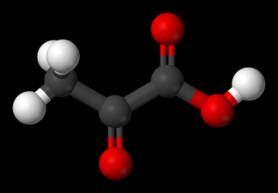
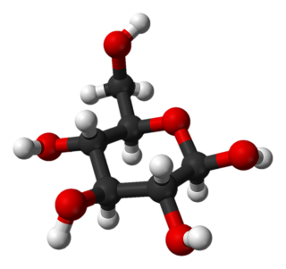
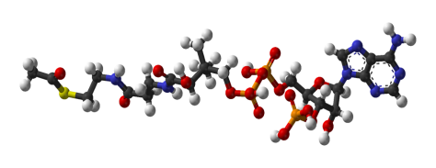
Cellular Respiration
Name__________________________Date____________Period____
Overall Respiration Equation: Balance
C₆H₁₂O₆ + ___O₂ + ___ADP + ___P ➔ ___CO2 + ___H2O + ___ATP
Name of molecule in the can to the right that is used to start Cellular Respiration ________________
Draw an arrow to the product above that’s produced during this part.
Acetyl
CoA
Name of Path 1________
Name of the molecules that make this process happen_______________
Path2
Total Number of ATP produced?_____
Any other energy products produced?
__________*
Name of these 2 molecules which are the products of the first pathof cellular respiration.
_________________
Path1
Name of
Path 2 _________
Path 3 to be continued.
Name of
Path 3:_____________
Name of the 4 carbon molecule
______________
# of ATP
_____
Name of the 6 carbon molecule
______________
What are the “waste products”?
_________
Path3
Name of the energy molecules that will be used in path 3.
_______________and______________

Slide 10
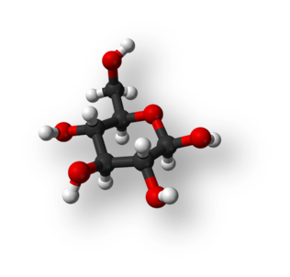
Cellular Respiration
Name ANSWER KEY Date____________Period____
Overall Equation
C₆H₁₂O₆ + 6O₂ + 36-38ADP +36-38P ➔ 6CO2 + 6H2O + 36-38ATP
Draw an arrow to the product above that’s produced during this part.
Acetyl
CoA
Name of molecule in the can to the right that is used to start Cellular Respiration
GLUCOSE
Name of Path 1GLYCOLYSIS
Name of the molecules that make this process happen ENZYMES
Part2
Total Number of ATP produced? 4
Any other energy products produced?
NADH*
Name of these 2 molecules which are the products of the first path of cellular respiration.
PYRUVATE
Path1
Name of
Path2
KREBS CYCLE
Path 3 to be continued
on the back.
Name of
Path 3:ELECTRON
TRANSPORT CHAIN
Name of the 4 carbon molecule
OXALOACETATE
# of ATP
2
Name of the 6 carbon molecule
CITRATE
What are the “waste products”?
CO2
Path3
Name of the energy molecules that will be used in part 3.
NADH and FADH₂

Slide 11
Path3
Cellular Respiration, cont’d
Name_______________________Date_________Period____
A:_____________________ B:__________________(ion)
C: _____________________ D:______________________
E: _____________________ F:______________________
G:______________(solvent) J:_______________________
Number of ATP produced ________
Number of ATP used________
Name of this Process_____________________
A
B
B
C
Name of this? ______________
B
NAD+
F
D
J
G
E

Slide 12
Path3
Cellular Respiration, cont’d
Name_______________________Date_________Period____
A: CELL MEMBRANE (PROK) B:HYDROGEN OR
INNER MEMBRANE OR CRISTAE (EUK) PROTON(ion)
C: ATP SYNTHASE D:ADP + P
E: ATP F WATER or ELECTRONS
G:CYTOSOL (PROK) J:NADH
MATRIX (EUK)
Number of ATP produced 32-34
Number of ATP used 0
Name of this Process ELECTRON TRANSPORT CHAIN
A
B
B
C
Name of this? ENZYME or CHANNEL PROTEIN or PROTON PUMP or
COMPLEX 1
B
NAD+
F
D
J
G
E

Slide 13
Using the information you’ve obtained about cellular respiration, answer the following questions.
Which pathways of cellular respiration are each of the following found?
How does each provide a cell energy?
Riboflavin
Glucose
Citric Acid
Niacinamide (Niacin)
Notes:
EVALUATION: Student groups could present these to the class.

Slide 14
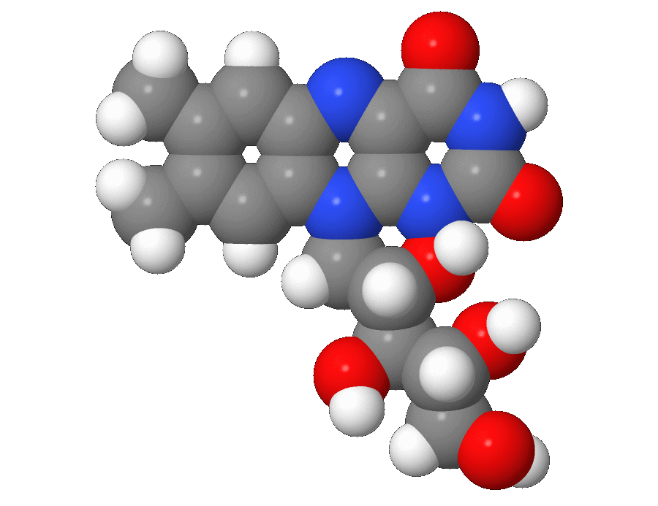
Which pathways of cellular respiration are each of the following found?
How does each provide a cell energy?
Riboflavin
Needed during the Kreb’s Cycle.
Riboflavin is a precursor molecule for making FADH₂, which is produced during the Kreb’s Cycle.
FADH₂ is a temporary energy storage molecule that will be used in the electron transport chain. FADH₂ stores electrons from the breakdown of citric acid (citrate)
Notes:
EVALUATION:

Slide 15
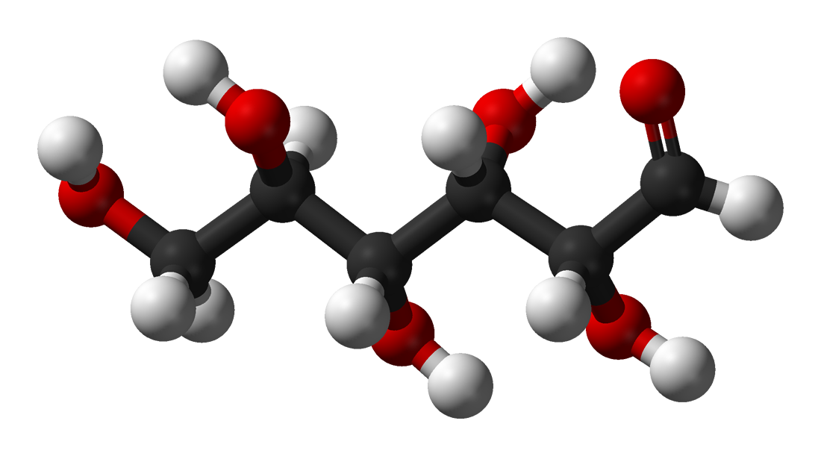
Which pathways of cellular respiration are each of the following found?
How does each provide a cell energy?
Glucose
Used during Glycolysis.
Electrons (energy) are removed from Glucose’s covalent bonds and given to the energy storage molecules, ATP and NADH.
Notes:
EVALUATION:

Slide 16
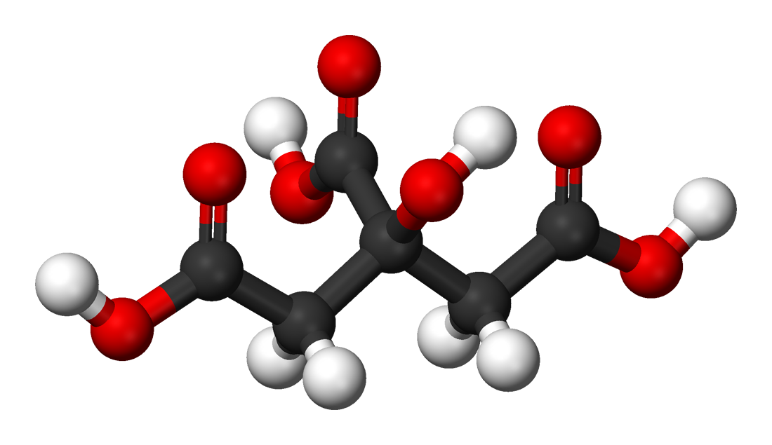
Which pathways of cellular respiration are each of the following found?
How does each provide a cell energy?
Citric Acid (Citrate)
Used during the Kreb’s Cycle.
Electrons (energy) are removed from Citric Acid’s covalent bonds and given to the energy storage molecules: FADH₂, ATP and NADH.
Notes:
EVALUATION:

Slide 17
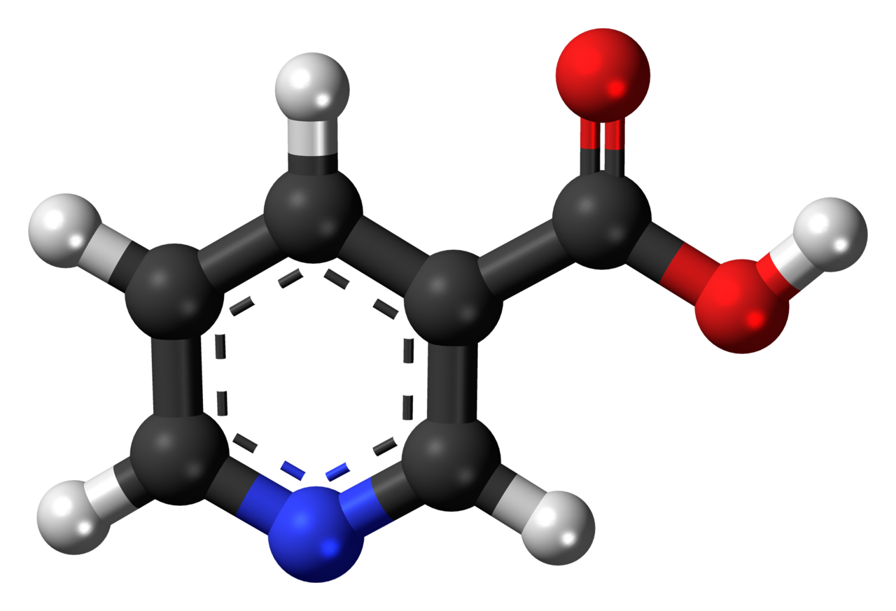
Which pathways of cellular respiration are each of the following found?
How does each provide a cell energy?
Niacinamide (Niacin)
Needed for Glycolysis, the Kreb’s Cycle, and electron transport chain.
Niacinamide is a precursor molecule for making NADH, which is produced during glycolysis and the Kreb’s cycle.
NADH is a temporary energy storage molecule that will be used in the electron transport chain. NADH stores electrons from the breakdown of many molecules.
Notes:
EVALUATION:

